Slide 1
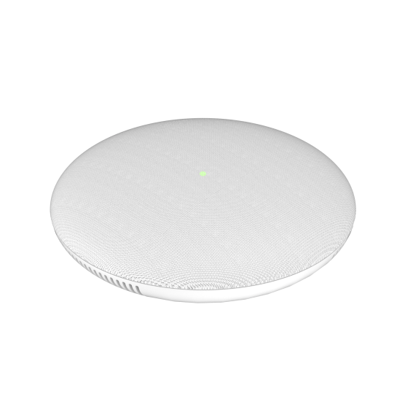
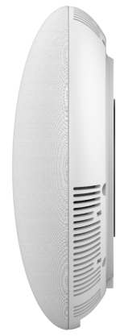
GSC3505 1-Way Public Address SIP Speaker
The GSC3505 is a 1-way public address SIP speaker that allows offices, schools, hospitals, apartments and more to build powerful public address announcement solutions that expands security and communication. This SIP speaker offers crystal clear HD audio functionality with a high-fidelity 8W HD speaker. The GSC3505 supports Bluetooth devices, a built-in whitelist and blacklists to easily block unwanted calls, SIP and multicast paging, and integrated dual-band WiFi.
Competitive Features
Speaker with HD acoustic chamber
SIP paging, multicast paging, call-waiting with priority override
Full-band and wide-band audio codec
Integrated dual-band 802.11 a/b/g/n WiFi
Integrated Bluetooth support
Web-UI access for control/configurations
One 10/100Mbps port with PoE/PoE+
 | GSC3505 | Cyberdata 011394 IP Ceiling Speaker | Cyberdata 011401 SIP Tile Speaker
Network Interfaces | One 10/100 Mbps port with integrated PoE/PoE+ | 10/100 Mbps | 10/100 Mbps
Power | Integrated PoE/PoE+ | Powered via PoE (802.3AF or 802.3AT) or 24V auxiliary power supply | Powered via PoE (802.3AF or 802.3AT) or 24V auxiliary power supply (not included)
Bluetooth | Yes, Integrated. Bluetooth 4.0 + EDR | No | No
WiFi | Yes, Integrated dual-band 802.11 a/b/g/n WiFi
Audio | HD Speaker: Full-band and wide-band audio codec support | Plays audio from Multicast, external volume control, high efficiency speaker driver | 802.3af - SPL 109.2 dB @ 1 meter 802.3at - SPL 111.9 dB @ 1 meter IGMP l SIP endpoint or Multicast group member
Security | SSL/TLS 1.2, AES256, SRTP, HTTPS, 802.1x media access control and in-band authentication | TLS/SSL 1.2, HTTPS or HTTP | TLS/SSL 1.2
Temperature and Humidity | Operation: 0°C to 40°C, Storage: -10°C to 60°C, Humidity: 10% to 90% Non-condensing | Operation: -30 to 55 C (-22 to 131 F), Storage: -40°C to 70°C, Humidity: 5% to 95% Non-condensing | Operation: -10 C to 50 C (14 F to 122 F), Storage: -40°C to 70°C, Humidity: 5% to 95% Non-condensing
Voice Codecs | G.711µ/a, G.722 (wide-band), G.726-32, iLBC, Opus, G.729A/B in-band and out-of-band DTMF (In audio, RFC2833, SIP INFO), VAD, CNG, AEC, PLC, AJB, AGC, ANS | Support for G.722 codecs | Support for G.722 codecs
8W high fidelity HD speaker
Integrated dual-band WiFi
10/100Mbps network port with PoE/PoE+
Integrated Bluetooth 4.0

